Slide 1
Demand Forecasting
Final Review
18/12/2018

Slide 2

| Agenda
Discussion of the problem statement
Data Overview
Examining the findings and insights from the data
About the model to be used for prediction
Showcasing the prediction model
Discussion of the next steps to be followed

Slide 3
XYZ Pharma approached Mu Sigma to forecast sales of a drug for the next six weeks across Germany
Team is unable to get an accurate model for predicting sales
The store managers at XYZ Pharma are responsible for predicting of sales for different stores
The store managers are unable to predict the sales accurately
XYZ Pharma wants help in predicting 6 weeks of sales across Germany
Outcomes - Store managers of XYZ Pharma were able to create effective staff schedules that increase productivity and motivation
Behavior - The team has incorporated the model provided by Mu Sigma to predict daily sales across Germany
Insights - Mu Sigma has designed a framework to predict the daily sales accurately based on the identified factors
Which model is needed to predict the sales accurately

Slide 4




The training data was analyzed and the identified factors were used to train the model to predict sales
Executive Summary
Train Data
Out of all sales data, 70% of the data was considered to train the model
On an average, there was sales of $9498 per day
Outcomes
Factors
Model Run
Store managers are able to effectively manage staff schedules based on the predictions
XYZ firm has a more accurate model for predicting sales of stores
The model selected for predicting sales of store is ‘ARIMA’
The model chosen was based on accuracy calculated from MAPE
State Holiday
School Holiday
Open
Promotion
Customers
Sales
Test Data
When the model was applied on the 10% test data, the predicted value for next 6 weeks came out to be $9345 per day

Slide 5
The data was sliced only for days when store was open as on closed days no sales was made
Column name | Description
State Holiday | For value=1 there was a state holiday For value=0 there was no state holiday
School Holiday | For value=1 there was a school holiday For value=0 there was no school holiday
Open | For value=1 the store was open For value=0 the store was not open
Promo | For value=1 promotion was run For value=0 promotion was not run
Date | Date in m/d/y
No. of customers | Total number of customers visiting the store on a given date
Sales | The sales of that store for the given date

Slide 6
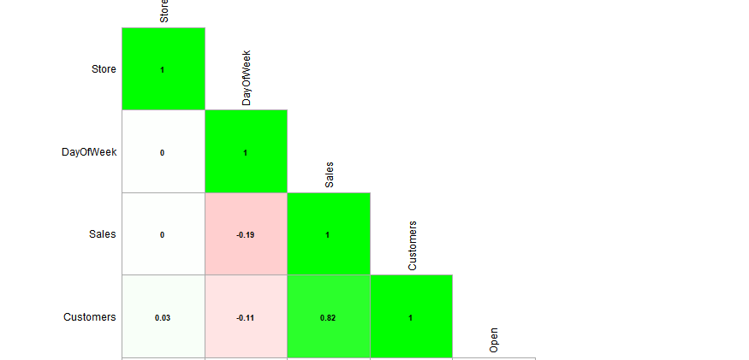
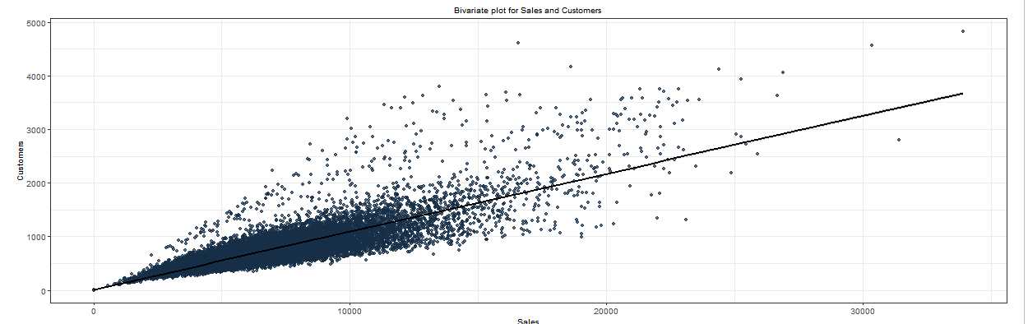
Exploration of data showed that the number of customers is strongly correlated with sales

Slide 7
Initial analysis showed promotions have a positive affect on sales especially when combined with holiday
Promotion

Slide 8

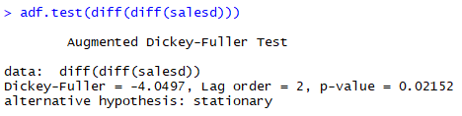
Double differencing was done on the data to make the time series stationary
Double Differencing needed
for stationarity

Slide 9
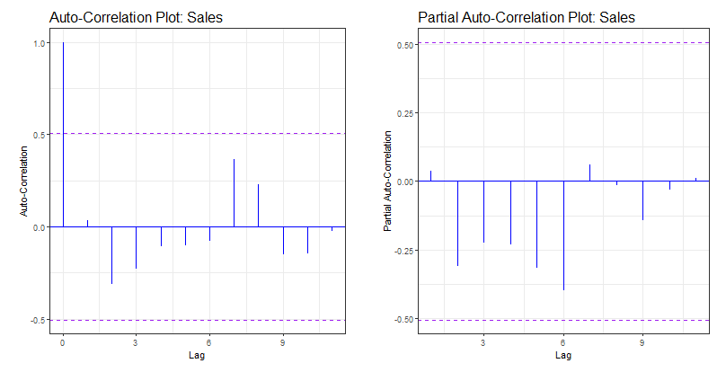
The ACF and PACF plots show that the data is non-seasonal

Slide 10
ARIMA Model was used to do the forecasting
Non Seasonal ARIMA model classification
p
d
q
Number of autoregressive terms
Number of differencing needed for stationarity
Lagged forecast errors in the prediction equation
0
2
2

Slide 11
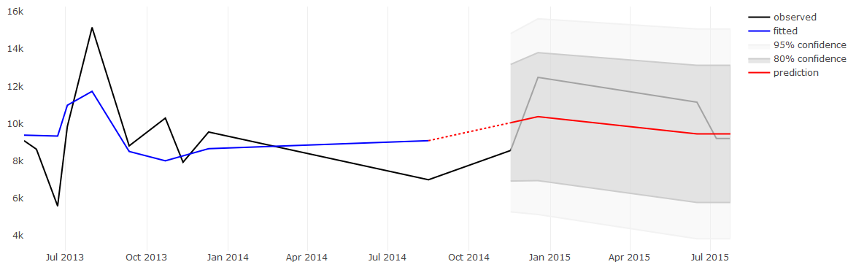

Validating the trained model gave MAPE value of 10(test) which shows the model is apt and is not overfitting
Forecasts from non-seasonal ARIMA (0,2,2)
Sales in $
Time
Accuracy

Slide 12
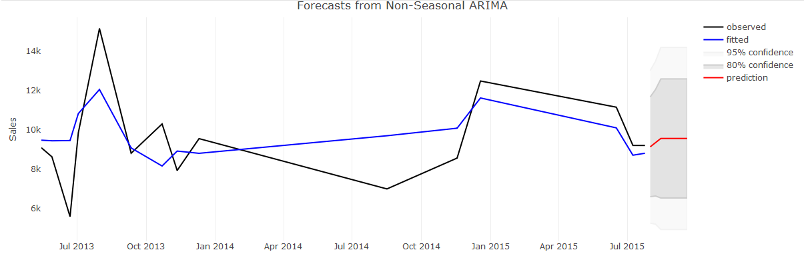
Further predictions on test data revealed forecasted sales for next 6 weeks to be $9345 per day
Time

Slide 13
With access to more in-depth data, Mu Sigma can provide XYZ with a more exhaustive framework
Next Steps
Monitor performance of stores when there is a holiday
Promotions must be encouraged in the event when store is open and there’s a school holiday which can increase sales
Incorporate the identified features to build a new model with better accuracy
Identify other metrics like doing promotions on a state holiday to increase sales of stores as soon as they open the next day

